Slide 1
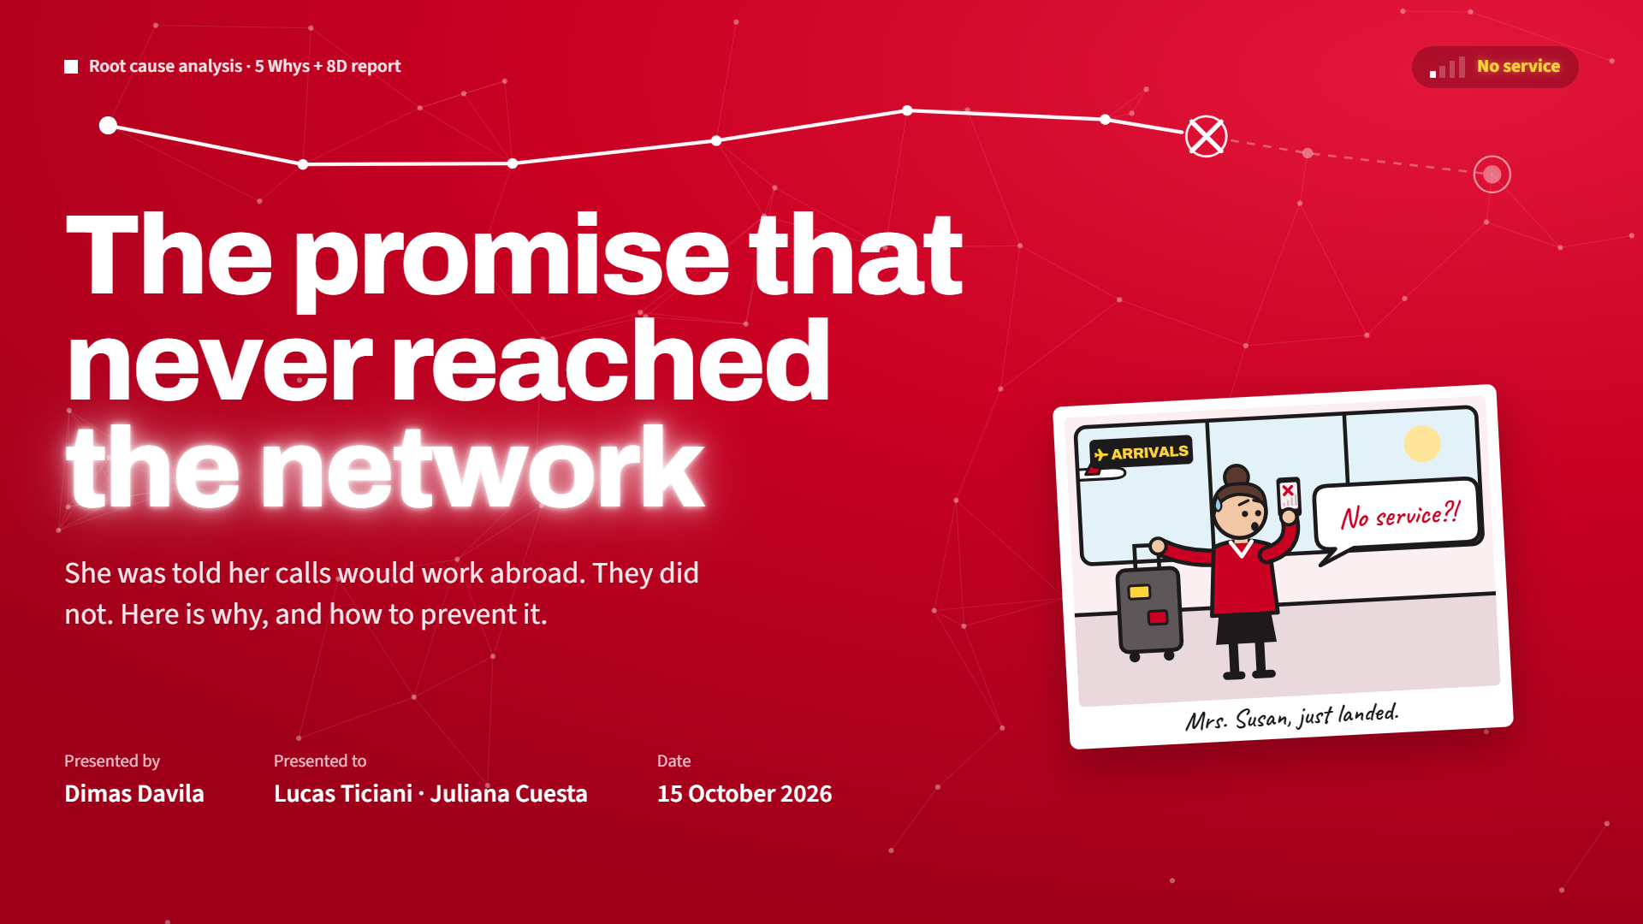
Notes:
Good morning Lucas, good morning Juliana. Thank you for having me today.
I will look at one customer complaint. First I find the root cause with the 5 Whys. Then I build a full 8D report, from D1 to D8.

Slide 2
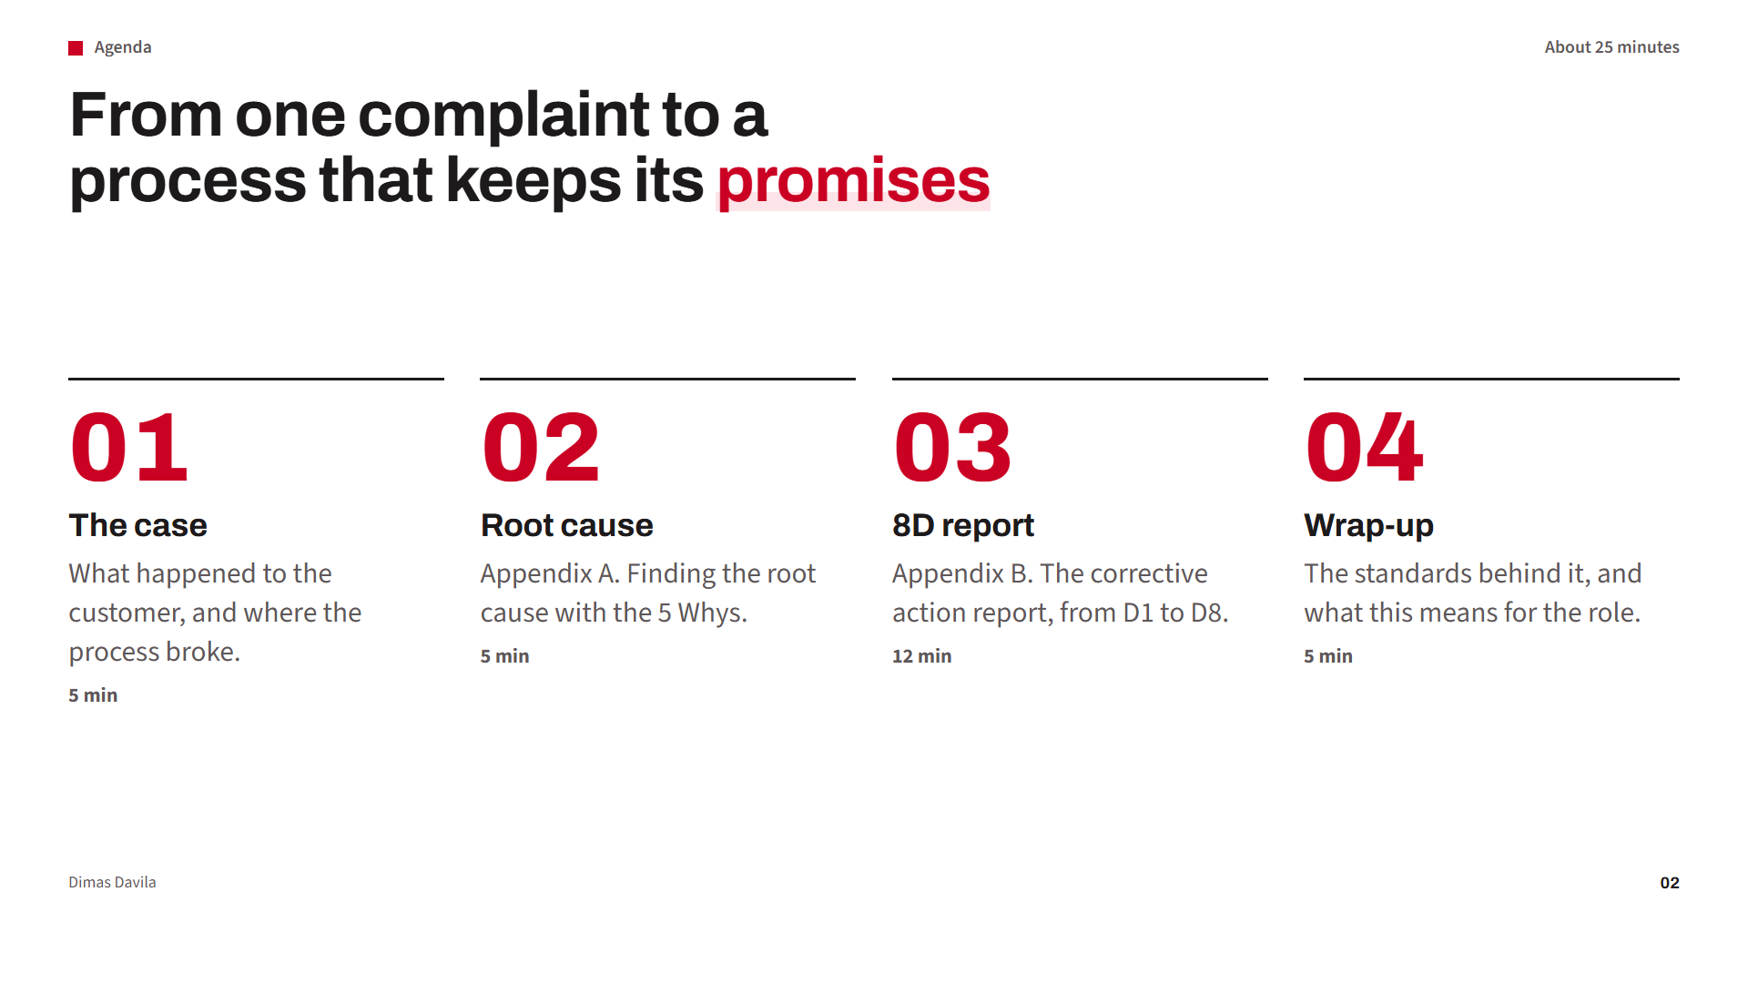
Notes:
Four parts. (Click for each.) First, the case. Second, the root cause, Appendix A. Third, the 8D report, Appendix B. Last, the standards behind it, and what this means for the role.

Slide 3

Notes:
Let me start with the case.

Slide 4
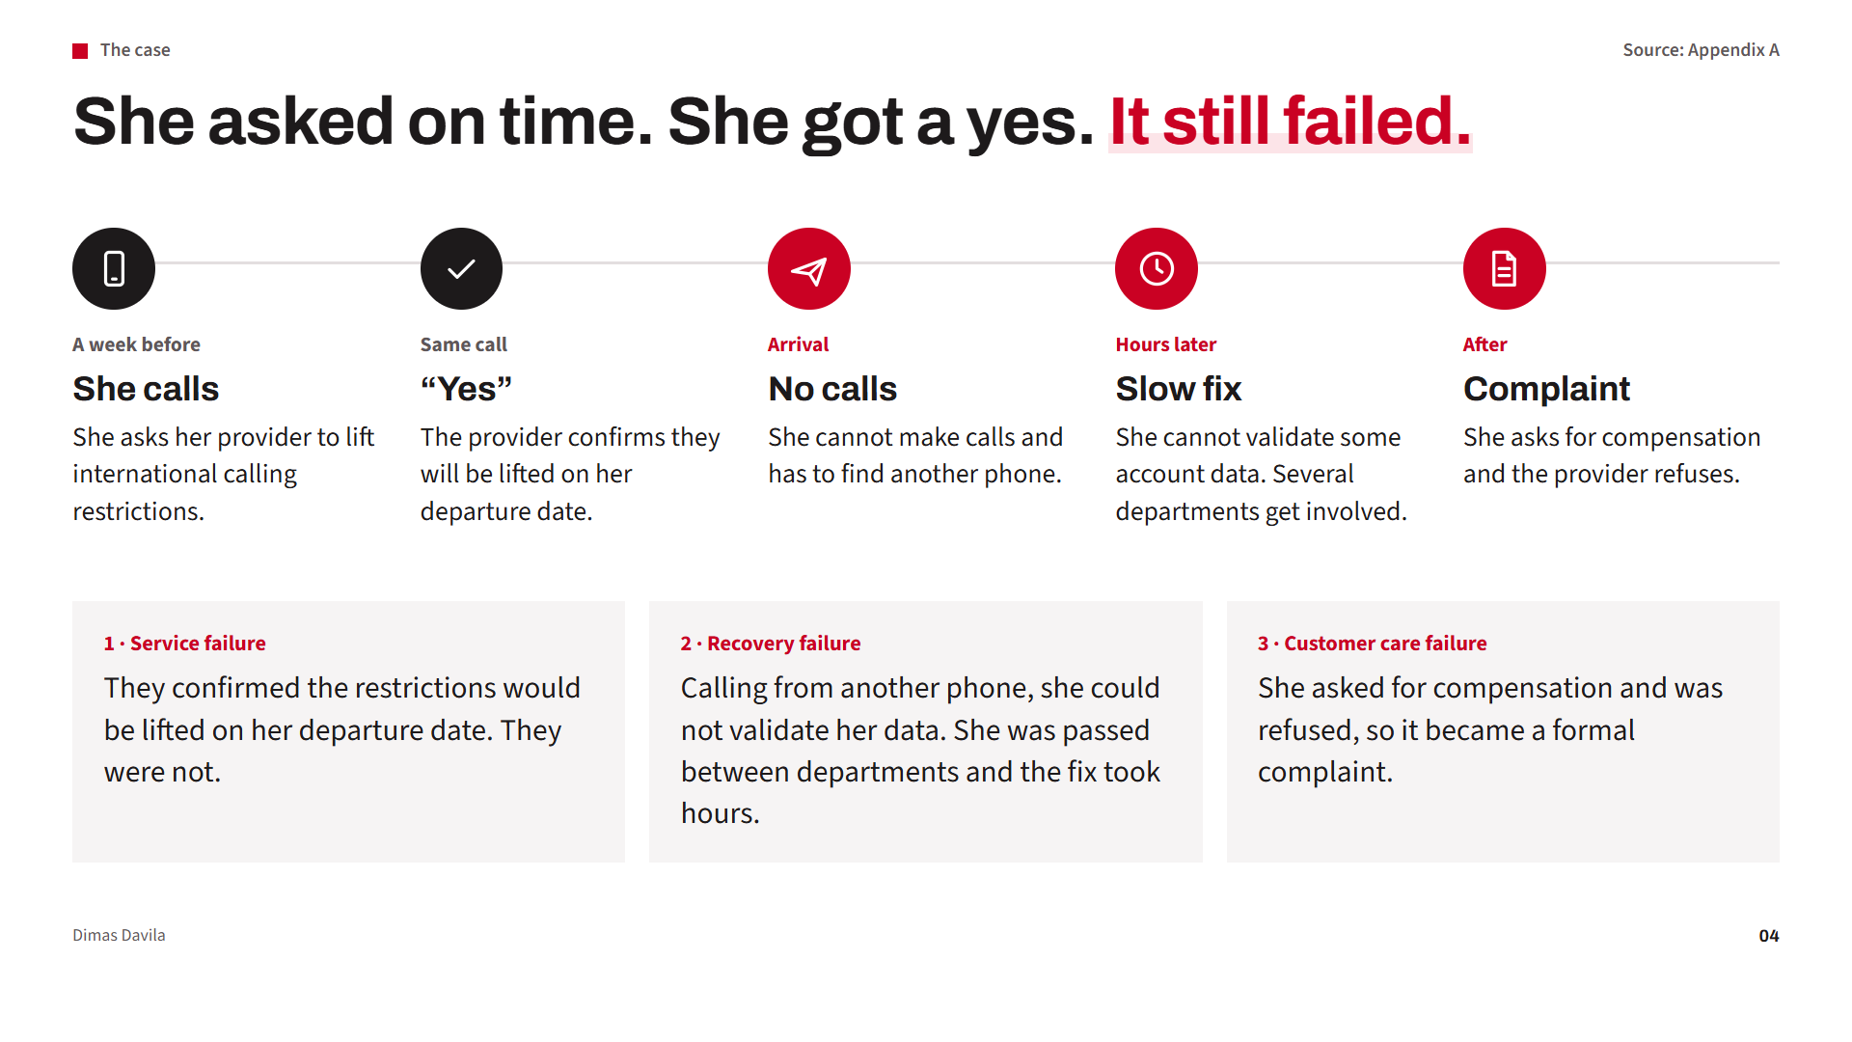
Notes:
Here is the story. (Click for each step.)
A week before her work trip, Mrs. Susan called her provider to lift the international restrictions. The provider said yes, from her departure date.
When she landed, she could not make calls. She had to find another phone. The fix took hours: she could not validate some account data and talked with several departments. Then they refused compensation, so she filed a complaint.
(Click) So there are three failures. One, a service failure: the promise was not delivered. Two, a recovery failure: she could not validate her data, was passed between departments, and it took hours. Three, a customer care failure: compensation was refused and it became a formal complaint.

Slide 5
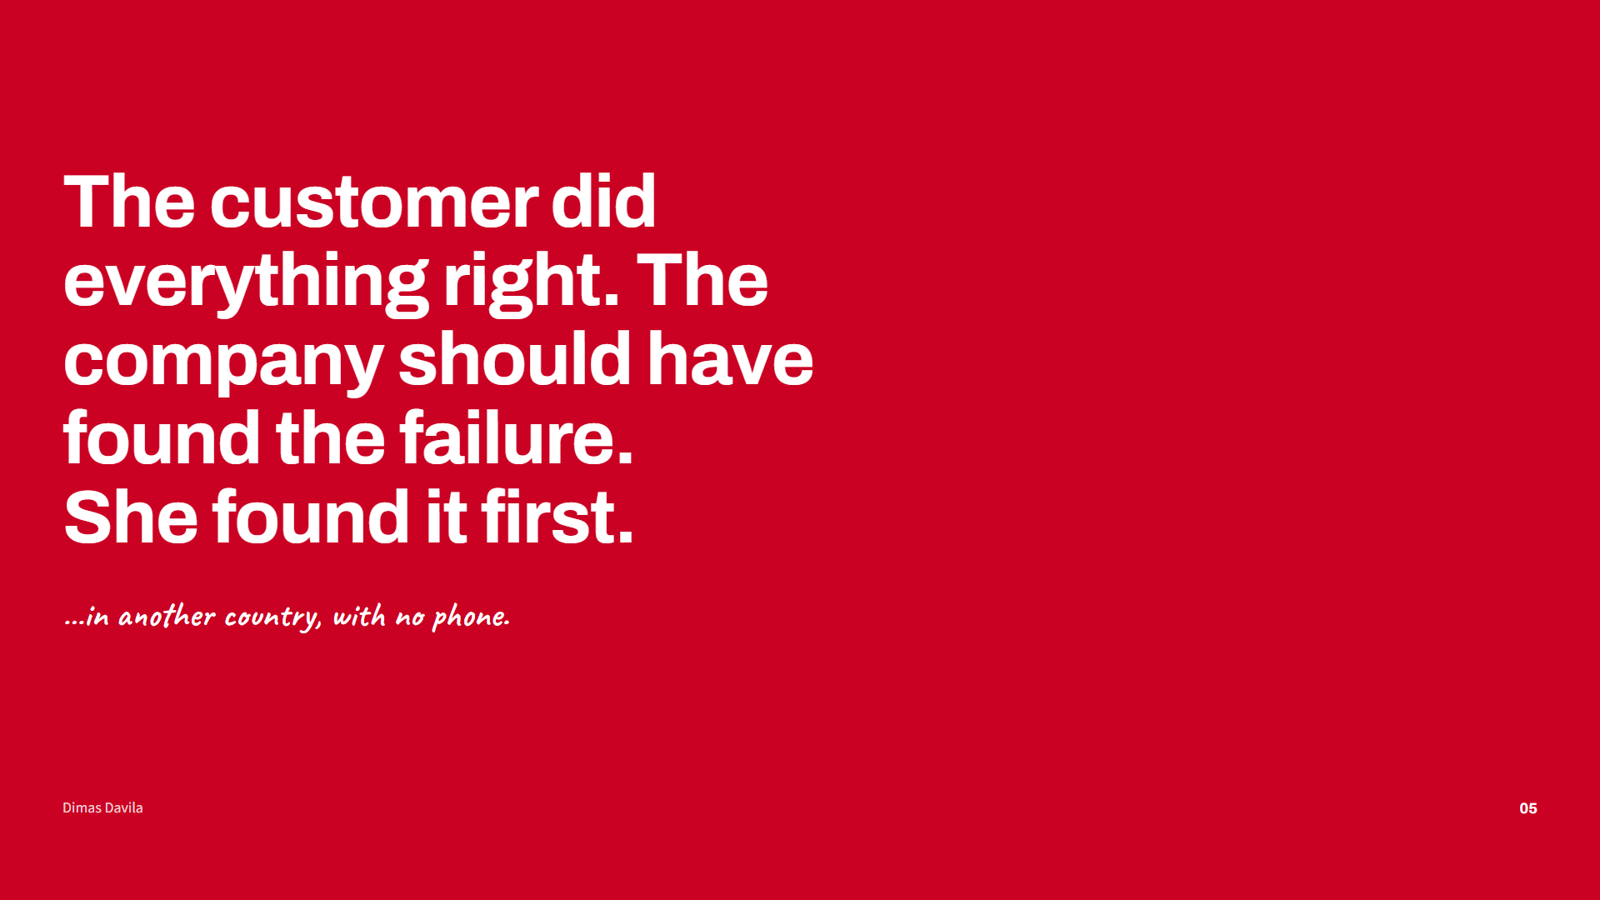
Notes:
This is the heart of the problem. She did everything right: she called a week early. The failure was inside the company, but she found it first, abroad, without a working phone. That is the worst way to detect a problem.

Slide 6
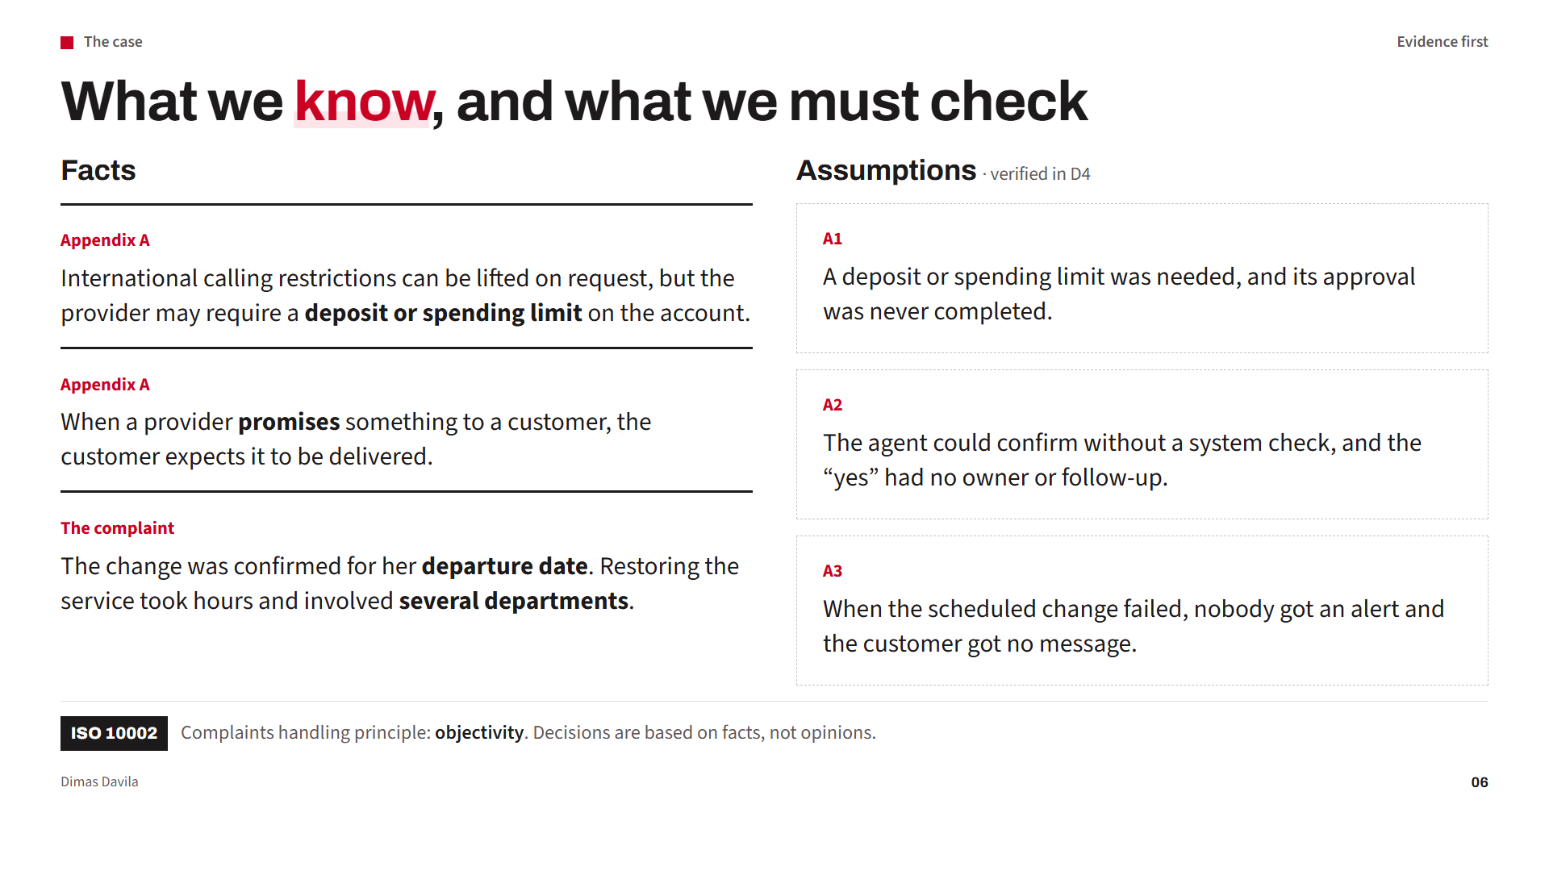
Notes:
Before I analyze, I separate facts from assumptions.
The facts come from the appendix. The first one is key: the provider may require a deposit or a spending limit. That is a condition that must happen first.
On the right, with dashed lines, are my assumptions. The appendix does not tell us why the change failed, so I do not treat them as true. In D4 I show how to verify them.
(Click) This is also a principle of ISO 10002: objectivity.

Slide 7
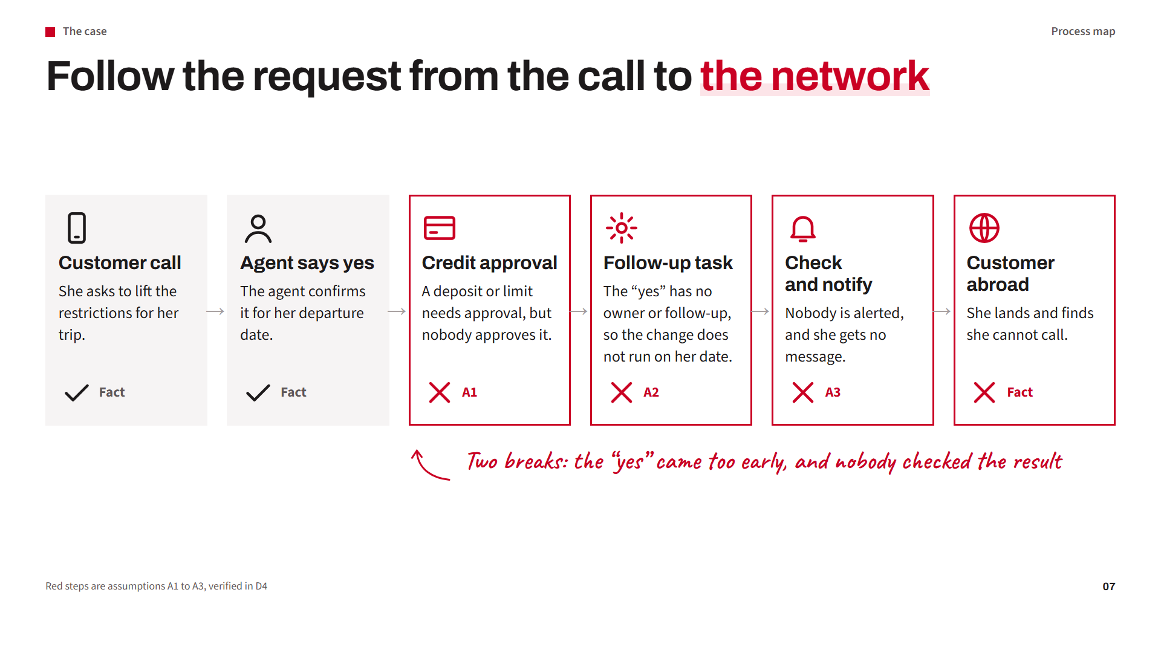
Notes:
This map follows the request from the call to the network. (Click for each step.)
The first two steps and the last one are facts from the appendix. The red steps in the middle are my assumptions: the credit approval was not completed, the agent's yes had no owner or follow-up so the scheduled change did not run, and nobody was alerted.
(Click) So there are two possible breaks: the yes came too early, and nobody checked the result. Now I analyze both with the 5 Whys.

Slide 8

Notes:
Part two, the root cause analysis from Appendix A.

Slide 9
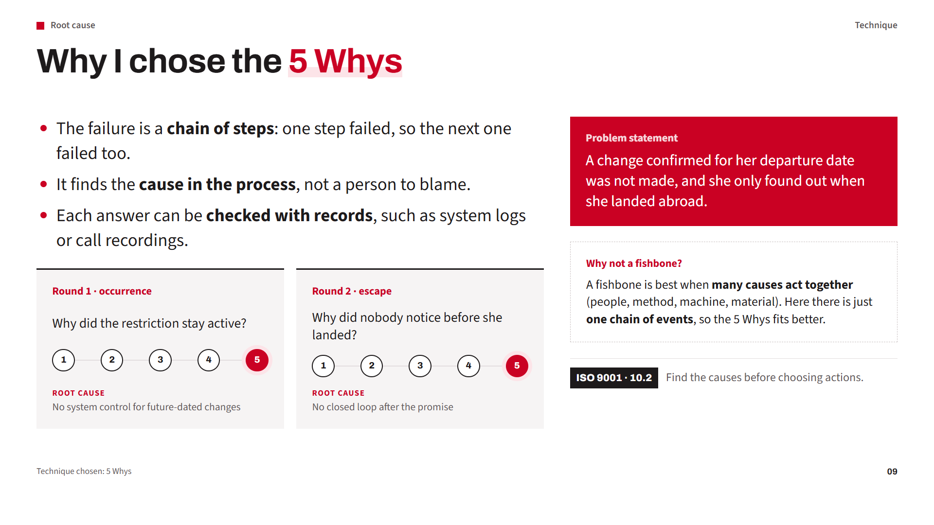
Notes:
The appendix asked for one technique. I considered the fishbone and the 5 Whys.
(Click for each point.) I chose the 5 Whys because this problem is a chain: one step failed, so the next one failed too. Each why leads to the next step, and each answer can be checked with a record.
(Click) Why not a fishbone? A fishbone is best when many causes act at the same time, for example in a manufacturing defect, where people, method, machine and material can all play a part. Here we have one sequence of steps, so the 5 Whys follows it more directly.
I use it twice: why it happened, and why nobody saw it.

Slide 10
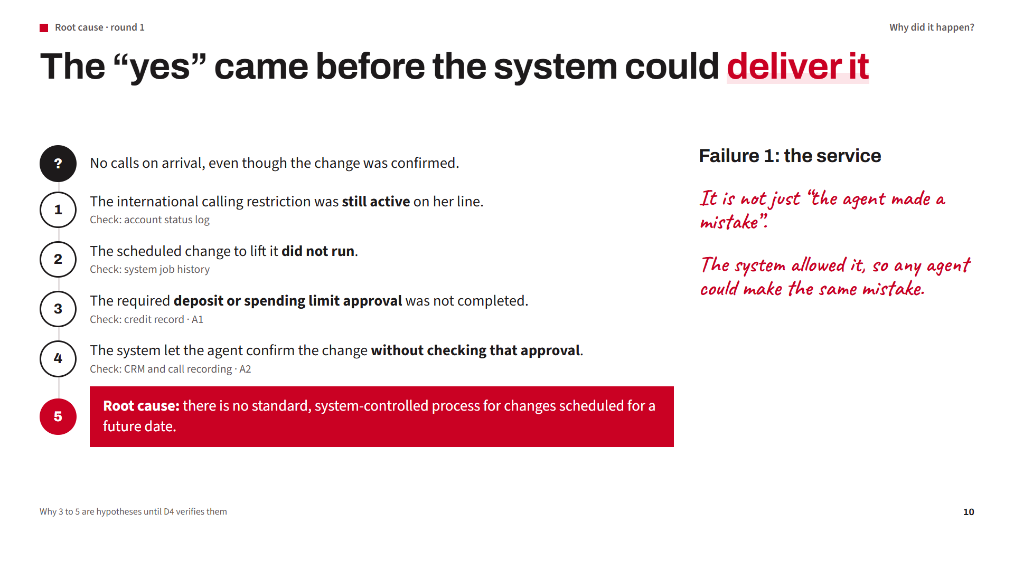
Notes:
First round: why did it happen? This is failure 1, the service failure. (Click for each why.)
Why 1: the restriction was still active. Why 2: the scheduled change did not run. Why 3: my hypothesis, based on the appendix, is that the deposit or limit approval was not completed.
Why 4 is the key step. It is easy to say the agent made a mistake. But if the system let the agent confirm without checking that condition, any agent could do the same.
Why 5, the root cause: there is no standard, system-controlled process for future-dated changes. The problem is the process, not the person.
Under each answer is the record I would use to check it.

Slide 11
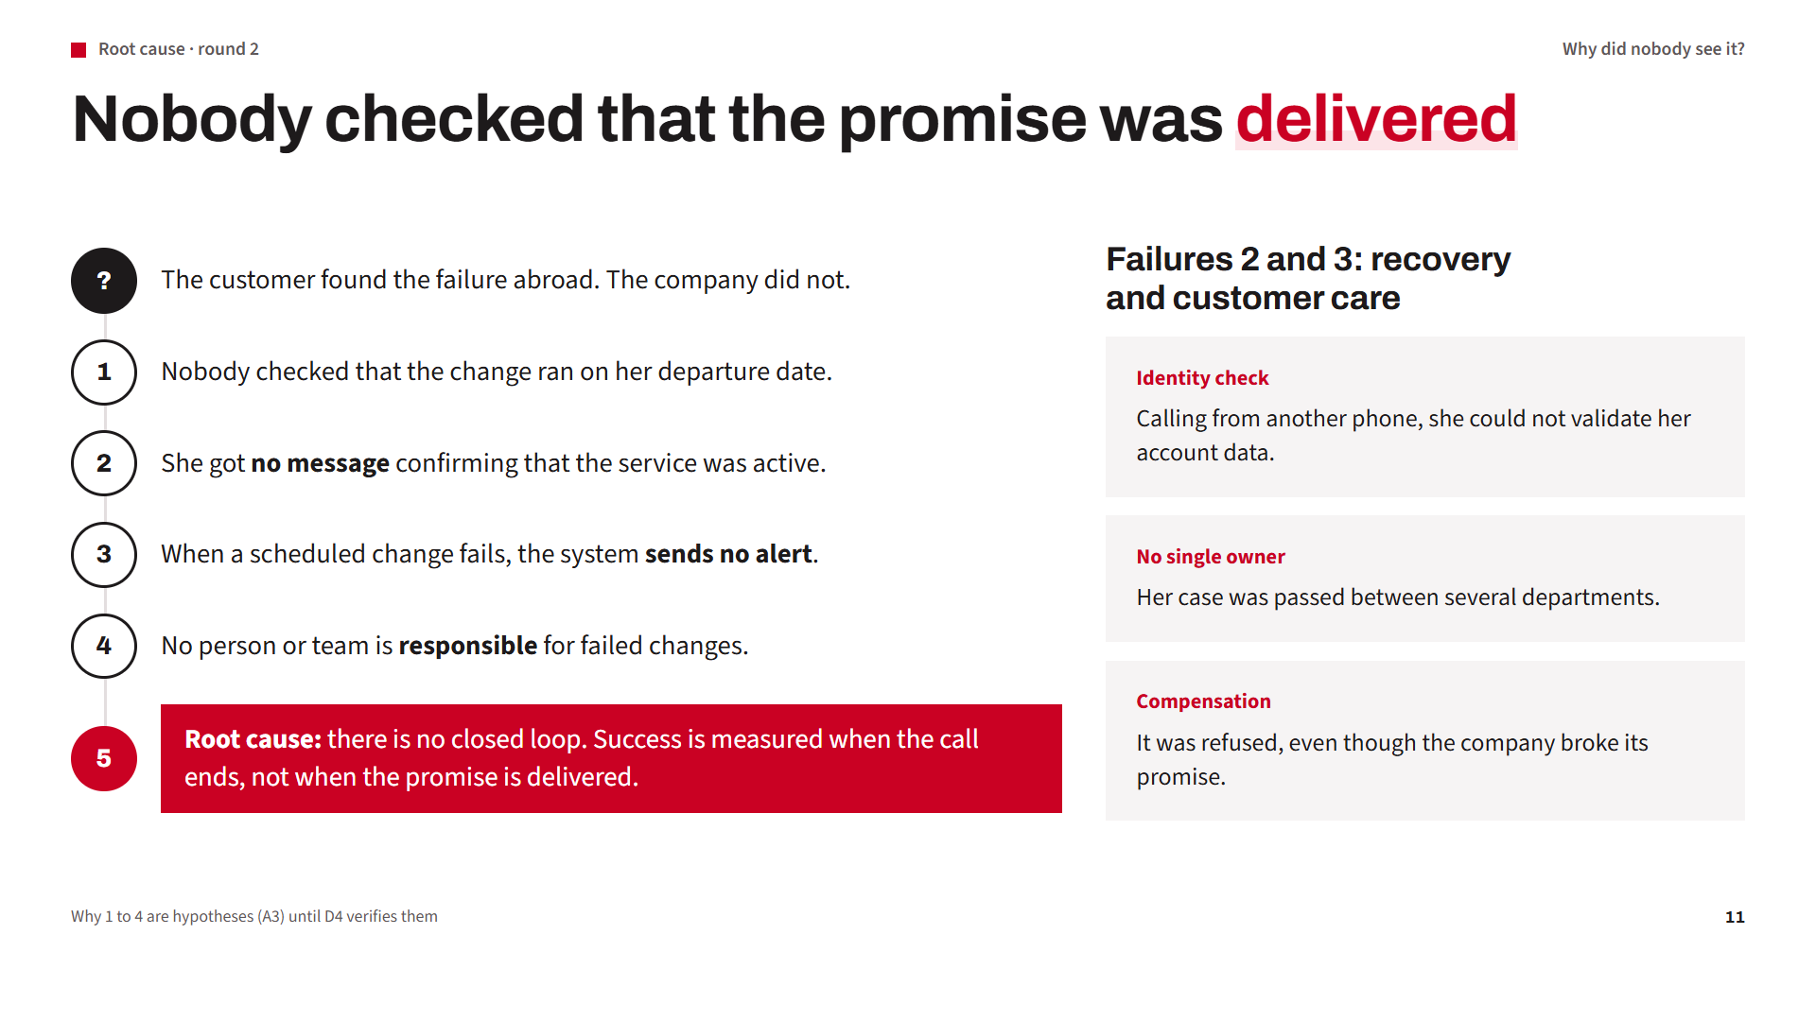
Notes:
Second round: why did nobody see it? (Click for each why.)
My hypothesis: nobody checked the change, she got no confirmation, a failed change sends no alert, and nobody owns it. The root cause: no closed loop. Success is measured when the call ends, not when the promise is delivered.
On the right are failures 2 and 3 from the complaint: the identity check from another phone, no single owner, and the compensation refusal. These are facts from the appendix, and I include actions for them.

Slide 12
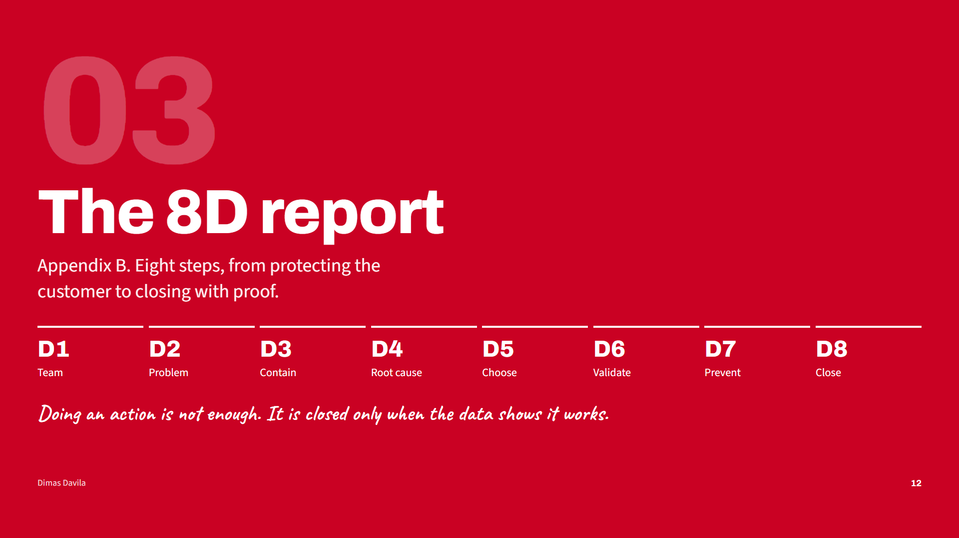
Notes:
Part three, the 8D report from Appendix B. One rule I follow: an action is complete when we do it, but it is closed only when the data shows it works.

Slide 13
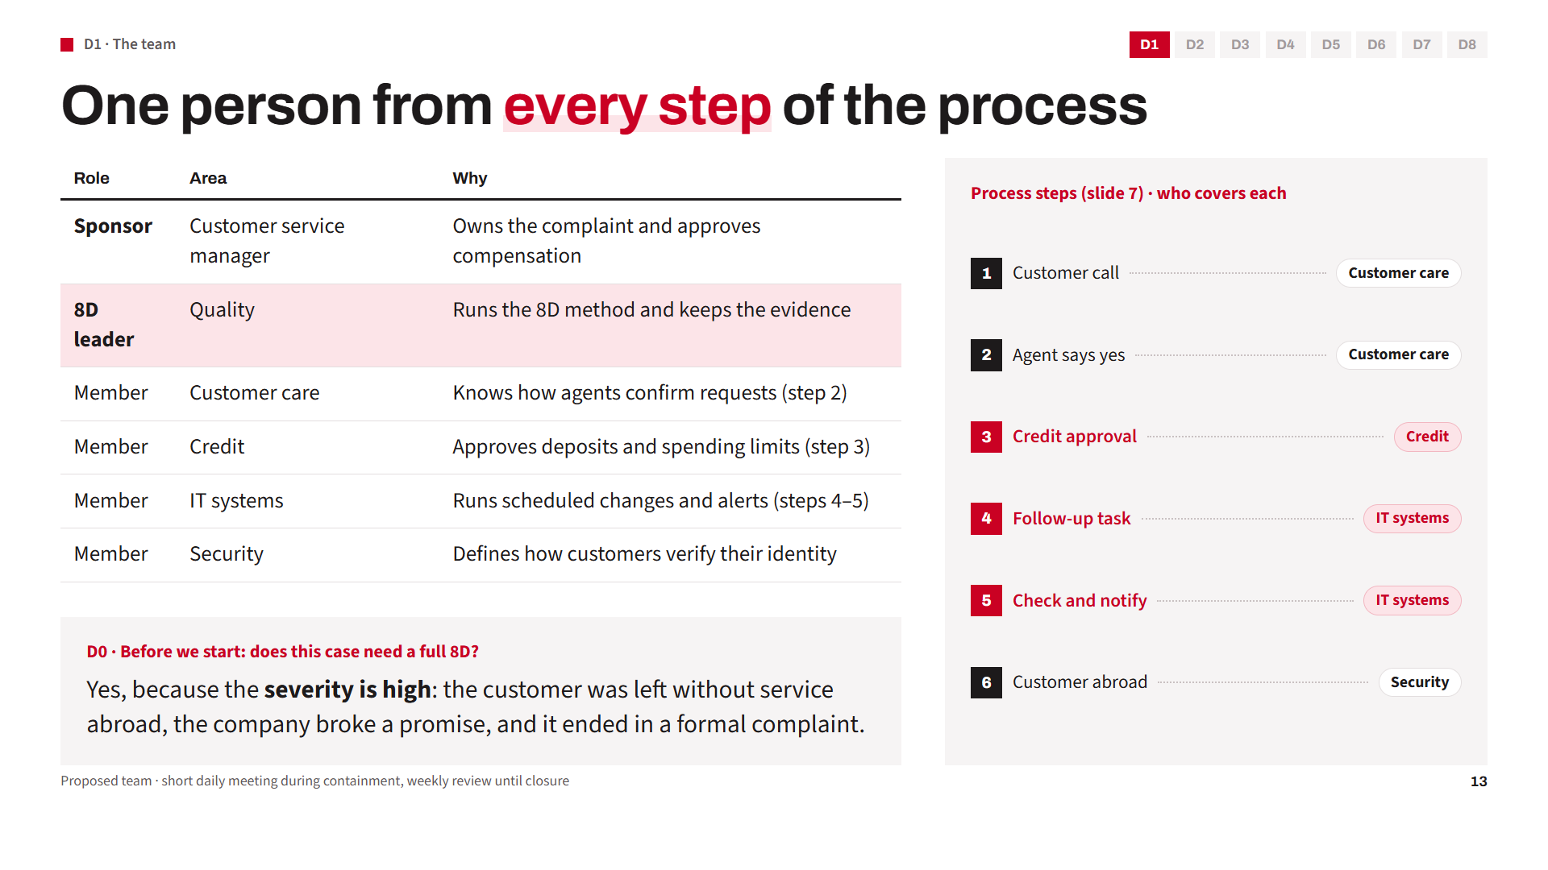
Notes:
D1, the team. I picked one person for each step of the process map. On the right you can see who covers each step: customer care for the call and the yes, credit for the approval, IT for the scheduled change and the alerts, and security for the identity check when the customer is abroad. If one area is missing, the solution has a blind spot.
A quick D0: is this serious enough for a full 8D? Yes. No service abroad is high severity.

Slide 14
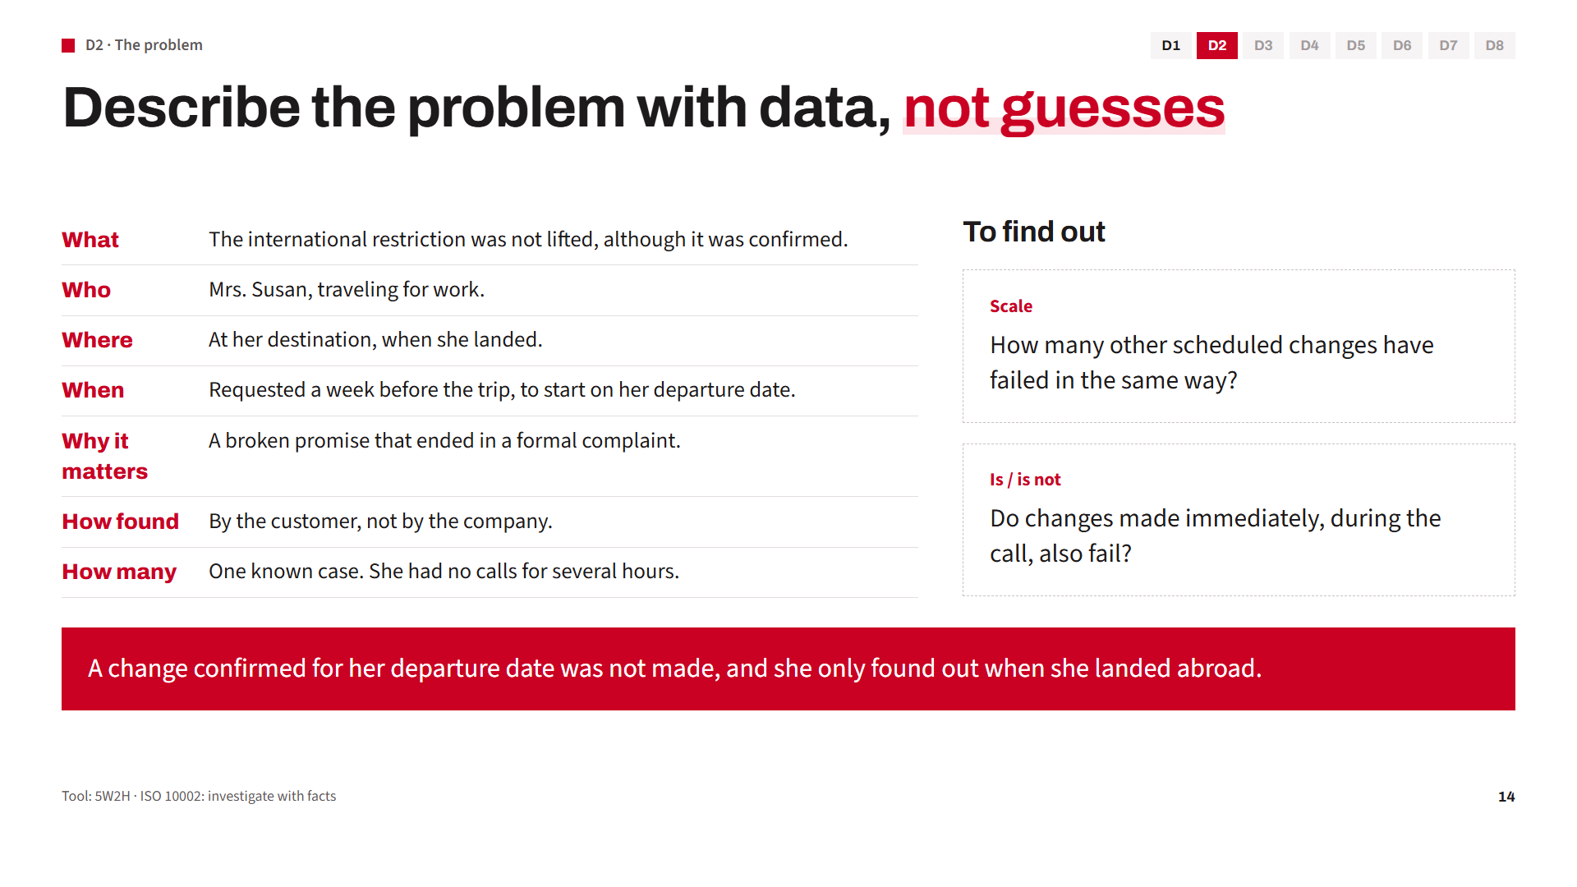
Notes:
D2. I use 5W2H: what, who, where, when, why, how, and how many. Everything on the left comes from the appendix.
On the right are two open questions. How many other customers have the same problem? And do changes made right away also fail? If not, the problem is in the scheduling.
(Click) And this is the problem statement.

Slide 15
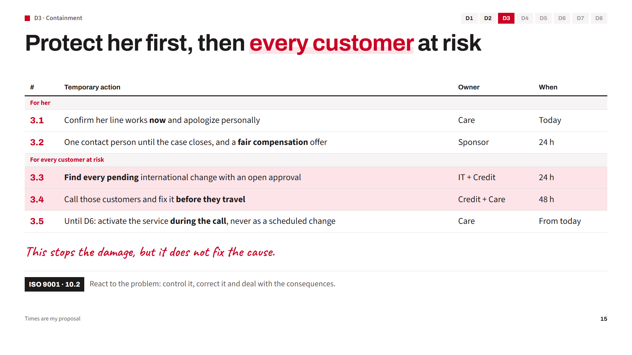
Notes:
D3, containment. Before looking for the cause, we stop the damage. (Click for each action.)
The first two are for Mrs. Susan. Today we confirm her line works and apologize personally. Within 24 hours she has one contact person and a fair compensation offer.
The next three protect every other customer. If this happened to her, it can be happening to others right now. In 24 hours we find every pending international change with an open approval, and in 48 hours we call those customers and fix it before they travel. And from today, until D6 proves the real fix, agents activate the service during the call instead of scheduling it.

Slide 16
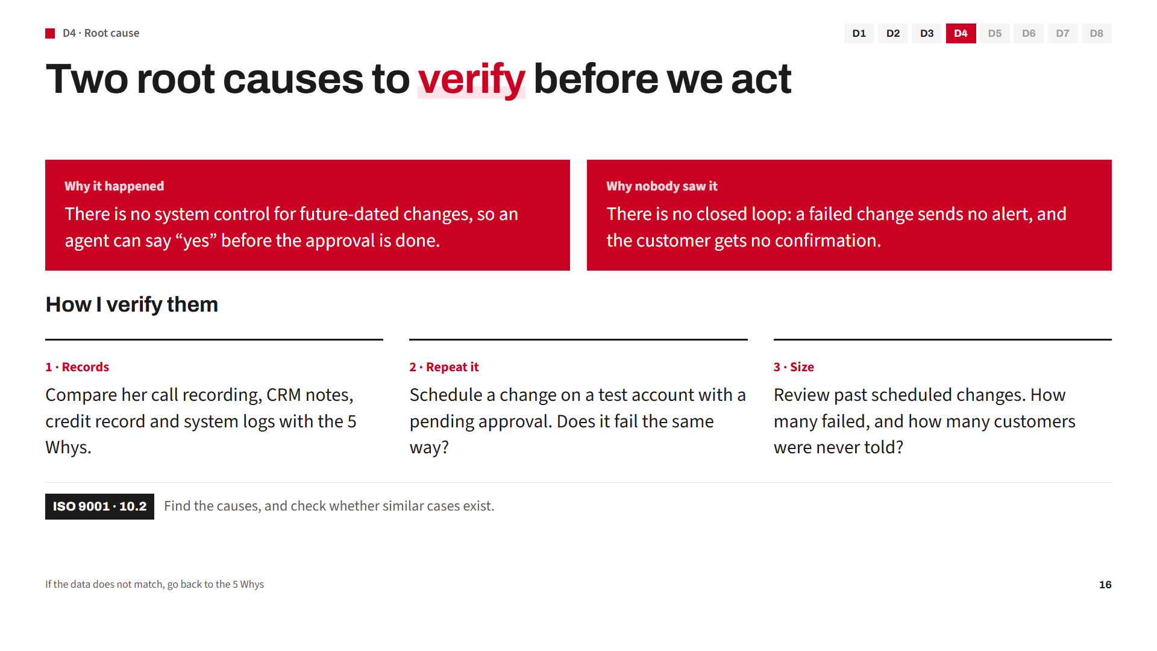
Notes:
D4. A 5 Whys is only a hypothesis until we verify it.
I verify it three ways: the records of this case, a test that repeats the problem, and past data to measure the size. If the evidence does not match, I go back to the 5 Whys. I do not act on a guess.

Slide 17
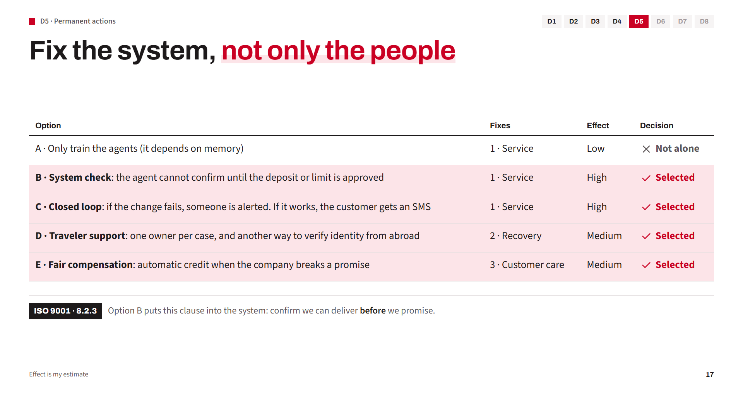
Notes:
D5. (Click for each option.) Training alone is not enough, because it depends on memory. B and C fix the service failure: no yes until the condition is approved, and an alert if a change fails. D fixes the recovery failure. E fixes the customer care failure.
(Click) Option B is ISO 9001 clause 8.2.3 inside the system: confirm we can deliver before we promise.

Slide 18
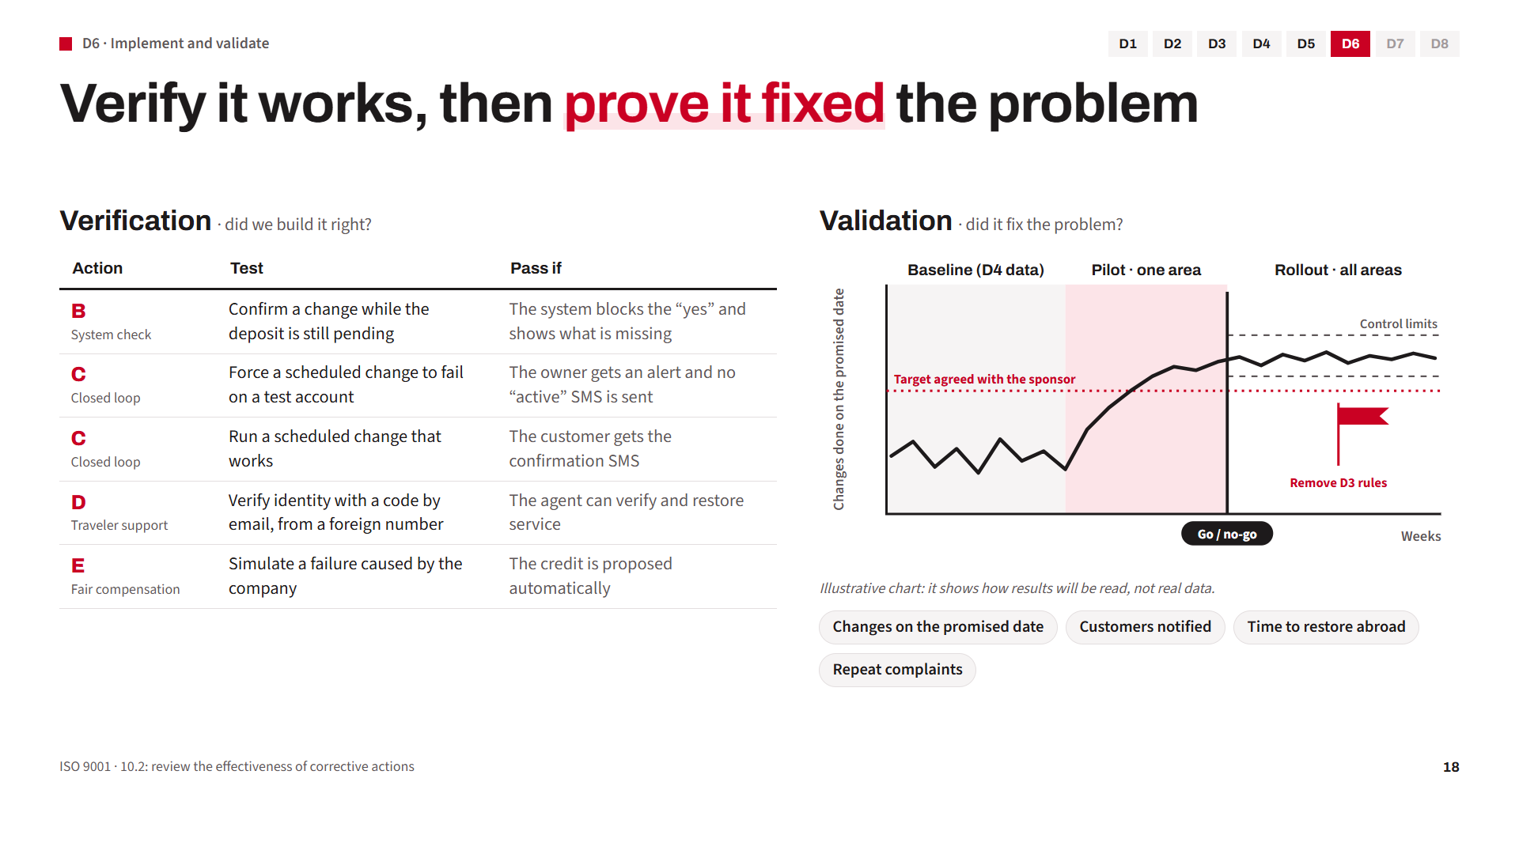
Notes:
D6 has two questions. (Click for each test.)
First, verification: did we build it right? For each action I define a test and a pass criterion. For example, for option B, we try to confirm a change while the deposit is still pending. It passes only if the system blocks the yes and shows what is missing. For option C, we force a change to fail on a test account, and the owner must get an alert.
(Click) Second, validation: did it fix the problem? I use a control chart. First the baseline, with the data from D4. Then a pilot in one area. If the indicator moves up to the target agreed with the sponsor, we pass the go or no-go gate and roll out. When the process stays stable inside the control limits, we remove the temporary rules from D3.
The chart is illustrative. It shows the method, not real data. The real numbers come from D4.
(Click) These are the four indicators I would follow.

Slide 19
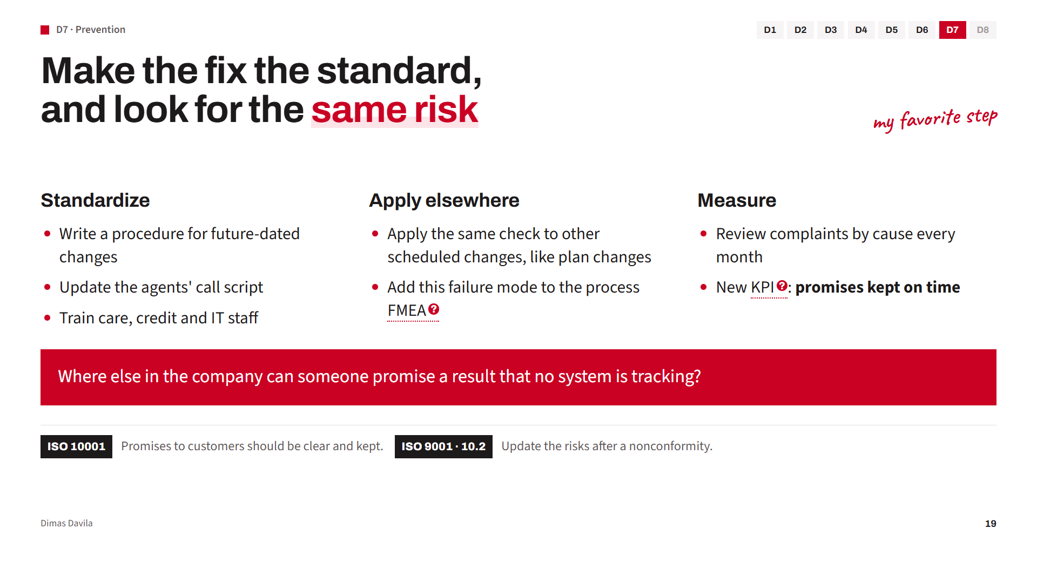
Notes:
D7, prevention. For me, the most valuable step.
We make the fix the standard: procedure, script and training. We look for the same risk in other scheduled changes, not only roaming. And we measure promises kept, not only call time.
(Click) The key question: where else can someone promise what no system is tracking?

Slide 20
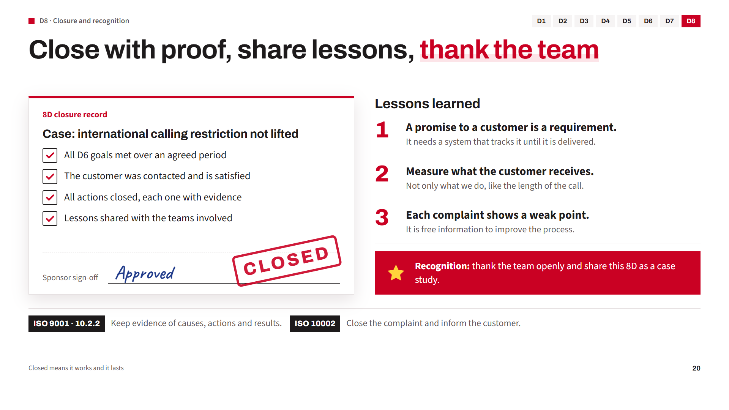
Notes:
D8, closure and recognition. (Click)
This is the closure record. We only close the 8D when every check is done: the D6 goals are met over an agreed period, the customer is contacted and satisfied, all actions are closed with evidence, and the lessons are shared. Then the sponsor signs, and the case is closed.
(Click for each lesson) These are the lessons. A promise to a customer is a requirement, and it needs a system that tracks it. We measure what the customer receives, not only what we do. And each complaint shows a weak point, so it is free information to improve.
(Click) Finally, we thank the team openly. When people feel recognized, they report problems instead of hiding them.

Slide 21
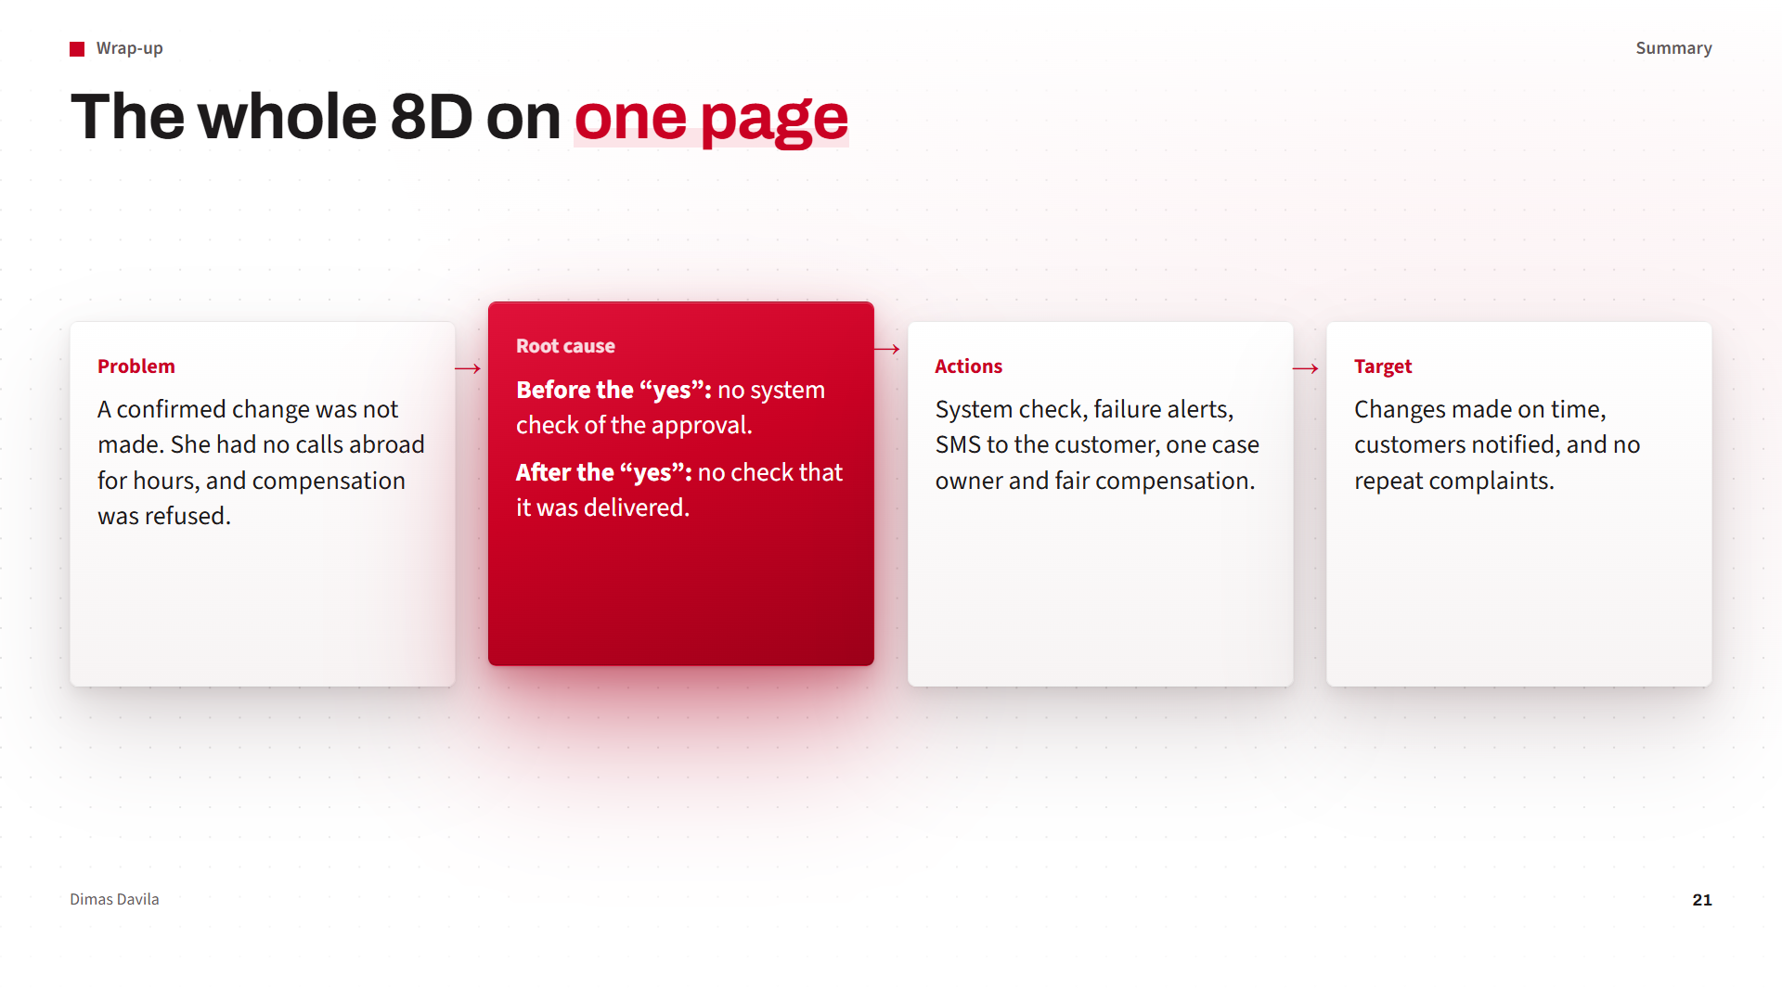
Notes:
The whole story on one page. (Click for each column.) The problem, the root causes, the actions, and the target.

Slide 22
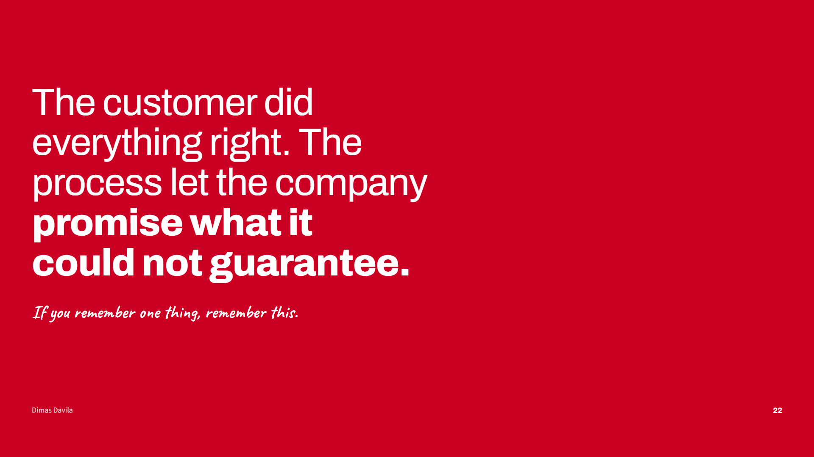
Notes:
If you remember one sentence from today, please remember this: the customer did everything right. The process let the company promise what it could not guarantee.

Slide 23
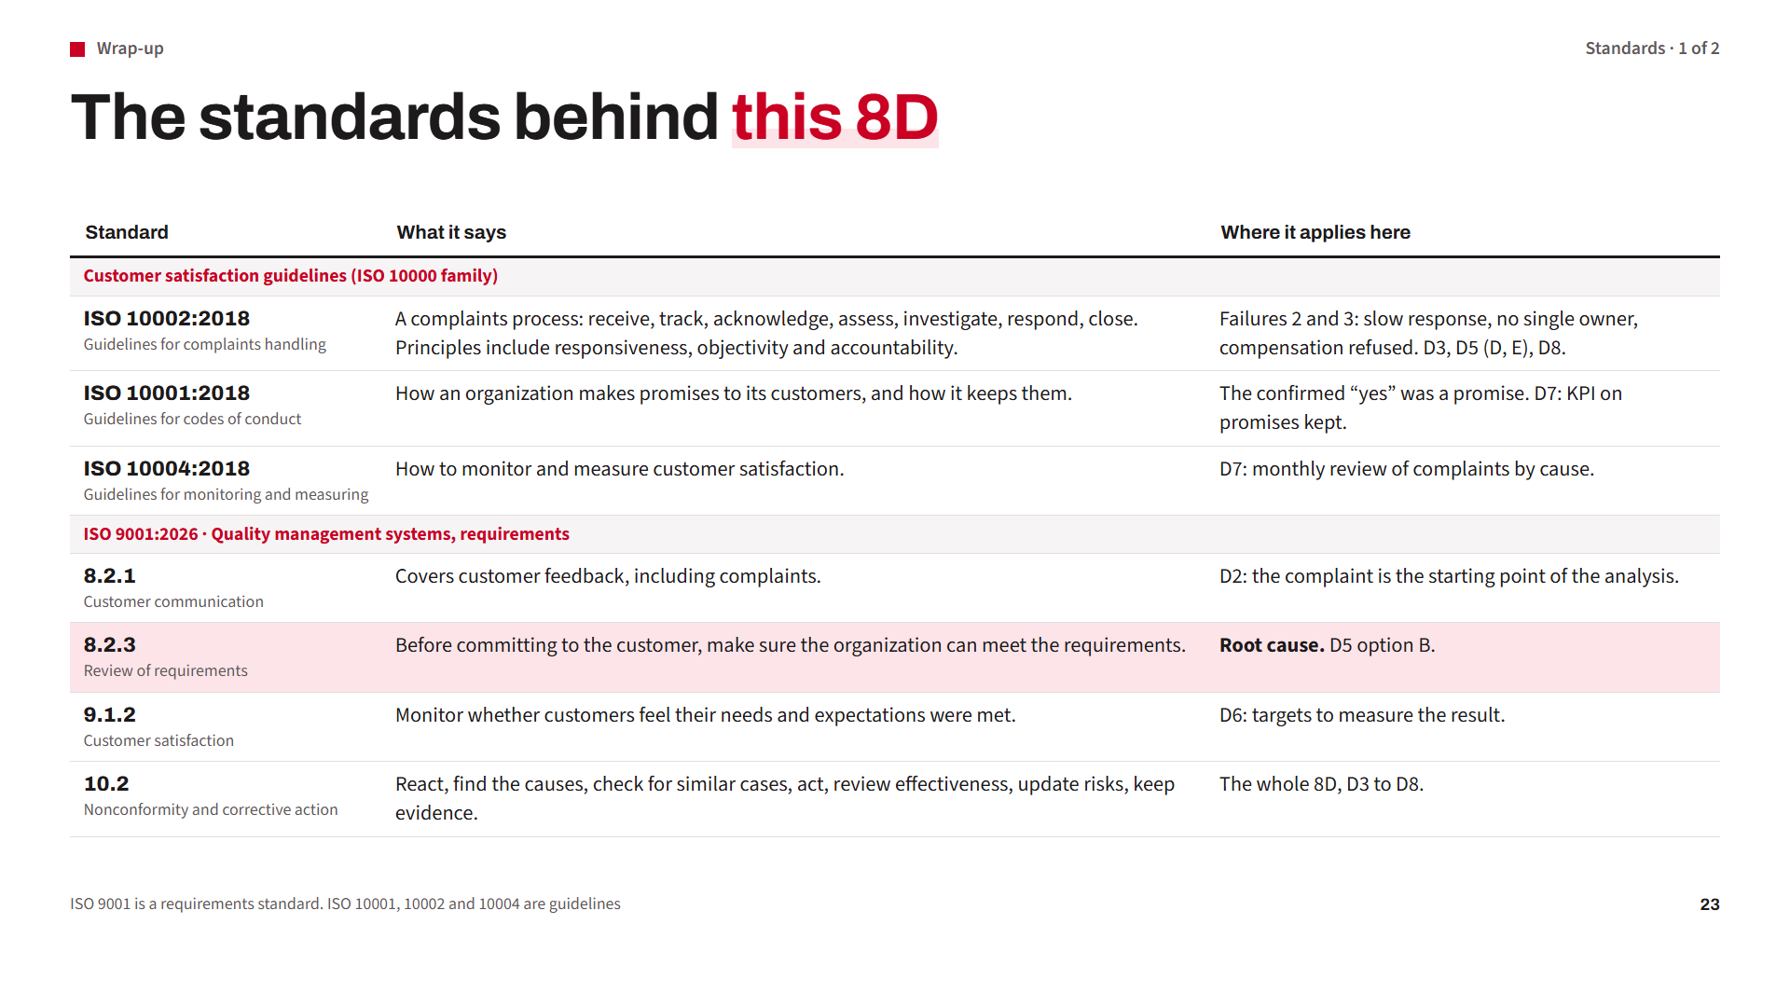
Notes:
This 8D is not only my own method. It follows the standards. (Click for each row.)
First, the ISO 10000 family. These are guidelines. ISO 10002 describes a complaints process: receive, track, acknowledge, assess, investigate, respond and close. Its principles include responsiveness, objectivity and accountability. Failures 2 and 3 in this case break those principles. ISO 10001 is about the promises a company makes to customers. The “yes” was a promise. ISO 10004 is about monitoring customer satisfaction.
Then ISO 9001, which has requirements. Clause 8.2.1 says customer communication includes complaints. Clause 8.2.3 is the key one: before committing to the customer, make sure you can meet the requirement. That is exactly our root cause. Clause 9.1.2 is customer satisfaction. And clause 10.2 is corrective action: react, find causes, check for similar cases, act, review effectiveness, and keep evidence. That is the 8D.

Slide 24
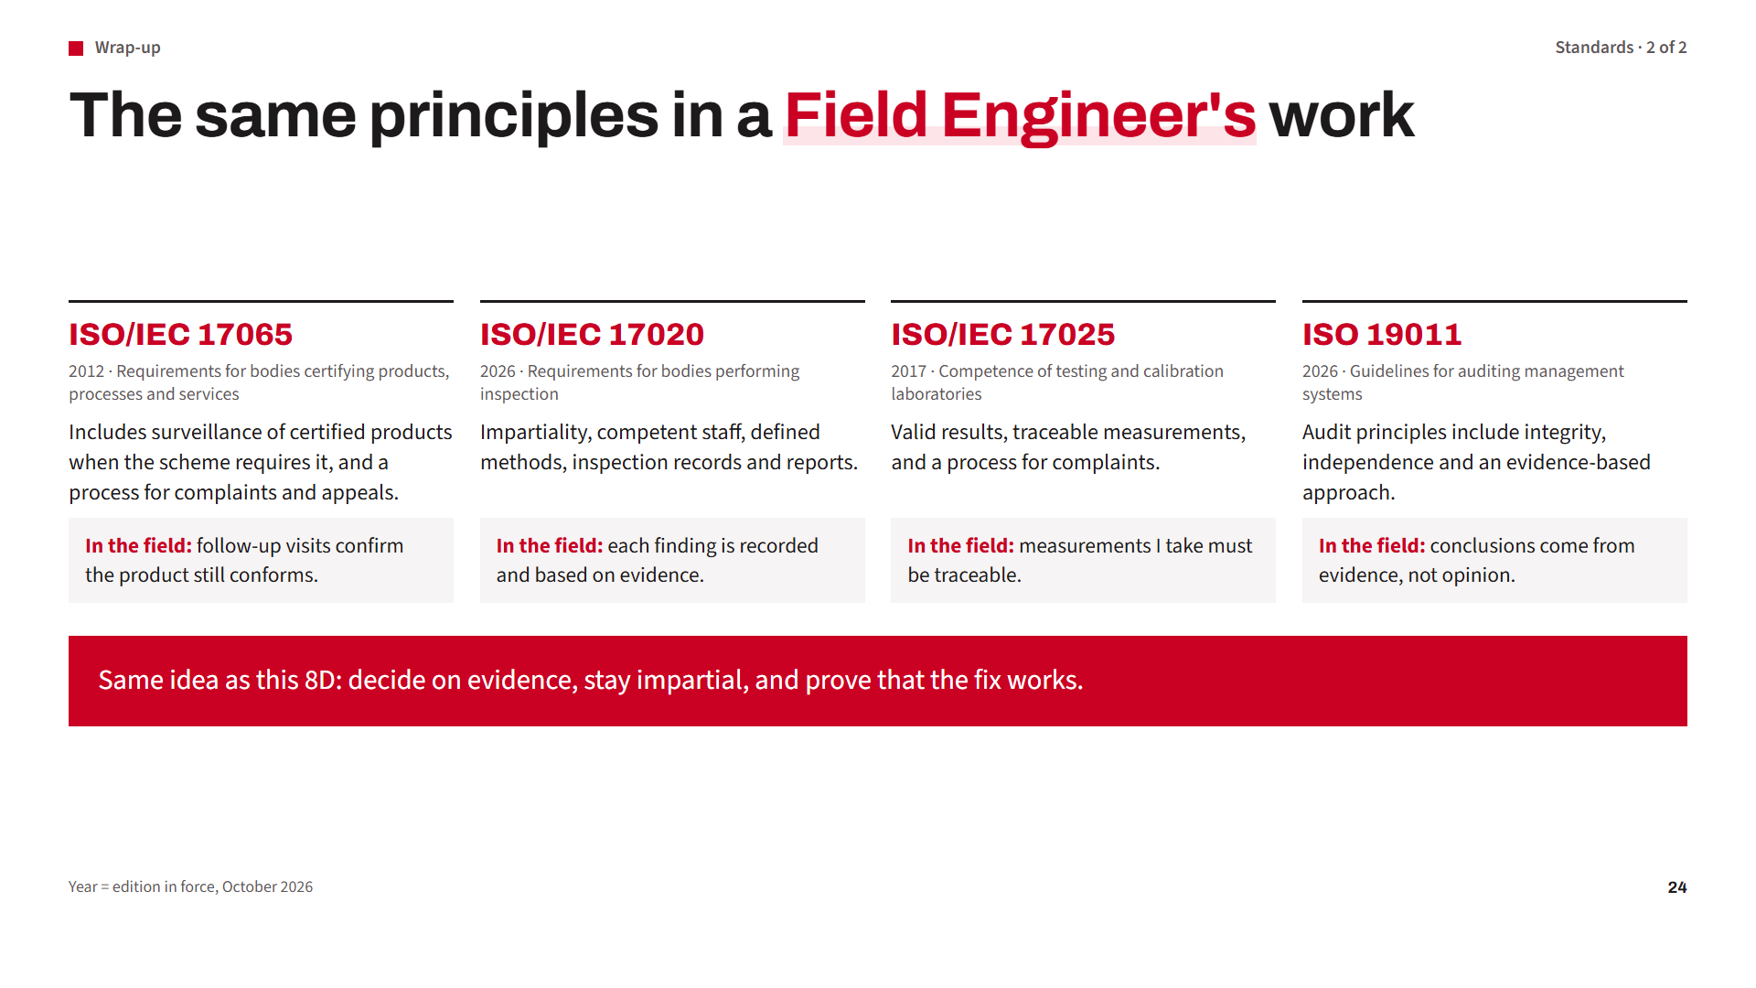
Notes:
Now the standards of a field engineer's world. (Click for each one.)
ISO/IEC 17065 sets requirements for product certification bodies. It includes surveillance of certified products when the scheme requires it, and a process for complaints and appeals. In the field, follow-up visits help confirm the product still conforms.
ISO/IEC 17020 sets requirements for inspection bodies: impartiality, competent staff, defined methods, and records. Every finding must be recorded and based on evidence.
ISO/IEC 17025 is for testing and calibration laboratories: valid results and traceable measurements.
And ISO 19011 gives guidelines for audits. One of its principles is the evidence-based approach.
(Click) It is the same idea I used today: decide on evidence, stay impartial, and prove that the fix works.

Slide 25
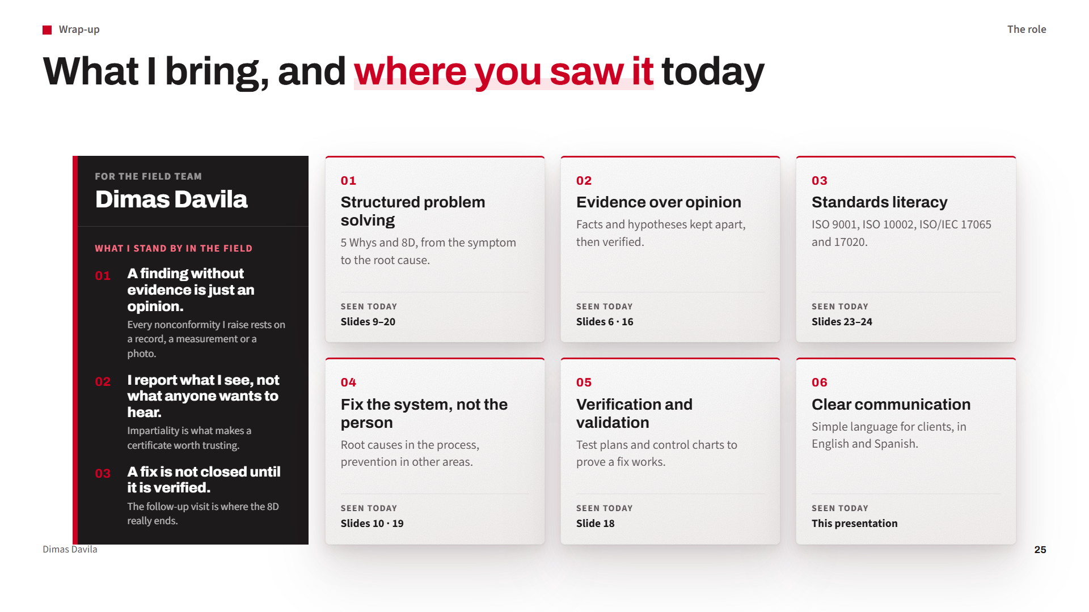
Notes:
To finish, I want to show what I bring to the team. I did not want to just list skills. Each one is something you saw today.
Structured problem solving: the 5 Whys and the 8D. Evidence over opinion: I separated facts from hypotheses and showed how to verify them. Standards: ISO 9001, ISO 10002, and the conformity assessment standards like ISO/IEC 17065 and 17020. Fixing the system, not blaming the person. Verification and validation, with a test plan and a control chart. And clear communication, in English and Spanish.
(Click: the photo card flips.) And three things I stand by in the field. A finding without evidence is just an opinion. I report what I see, not what anyone wants to hear, because impartiality is what makes a certificate worth trusting. And a fix is not closed until it is verified: the follow-up visit is where the 8D really ends.
[PERSONALIZE: add one short real example. “In my last job, we had a problem with ___. I contained it by ___. The root cause was ___. After the fix, ___ improved.”]

Slide 26
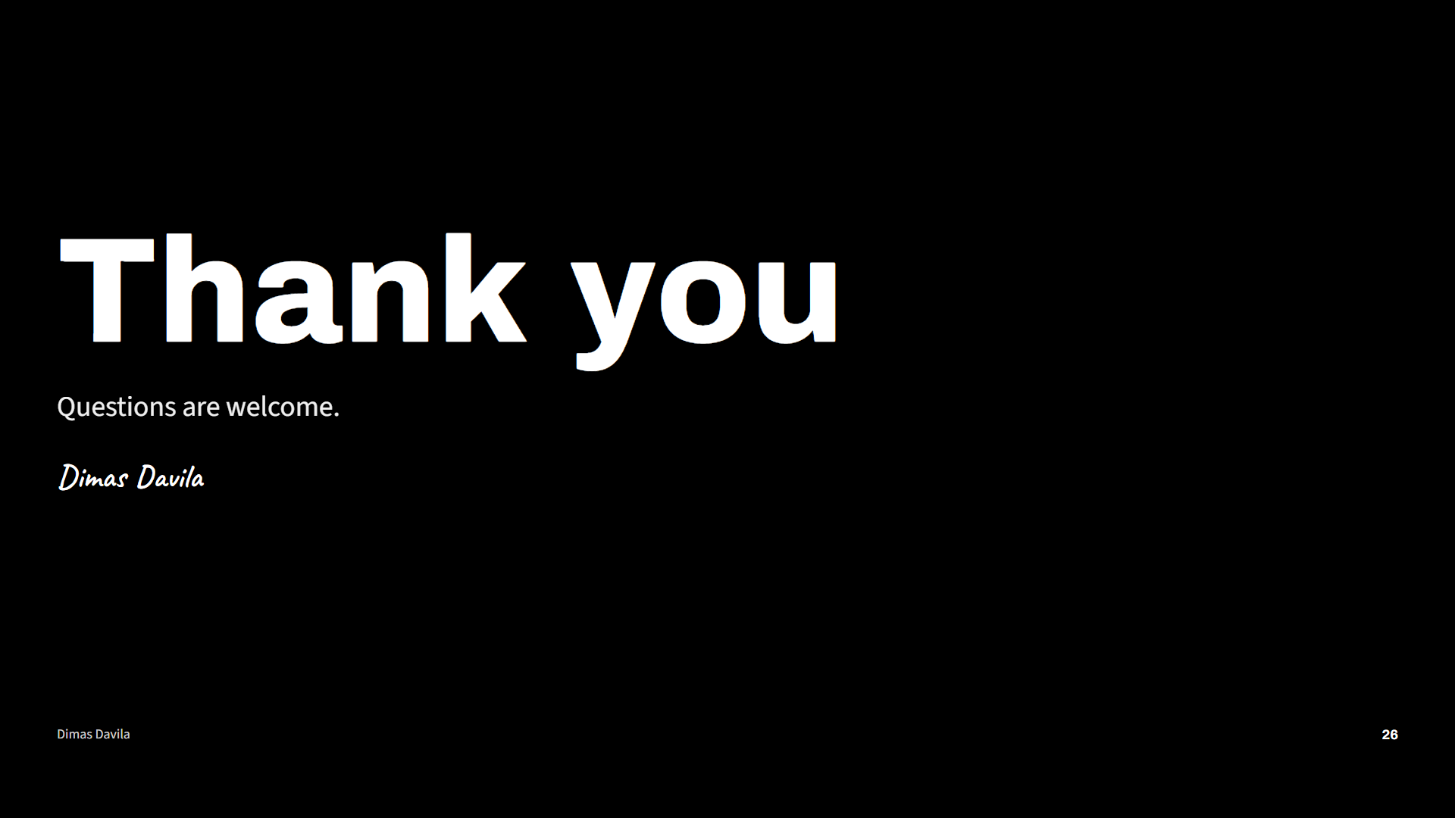
Notes:
Thank you very much for your time. I am happy to answer your questions or go deeper into any step.

